Slide 1
Creative expression: benefiting from your copyright & using the copyright works of others in your business
Presented By: joan e. webley
Manager of copyright & related rights
June 5, 2012

Slide 2
Creative expression: benefiting from your copyright & Using Copyright works of others
OVERVIEW:
PART ONE: Copyright 101: Why? What? How?
PART TWO: Proof of Ownership issues
PART THREE: Benefiting from Your Copyright
PART FOUR: Using Copyright Works of Others
FREQUENTLY ASKED QUESTIONS

Slide 3
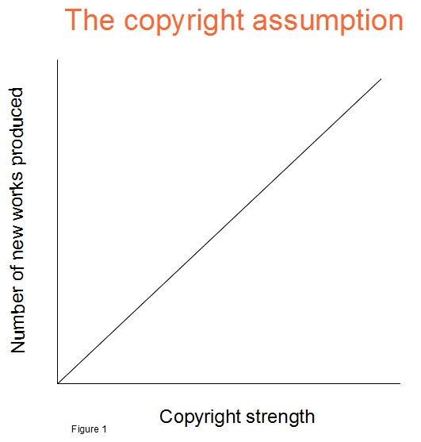
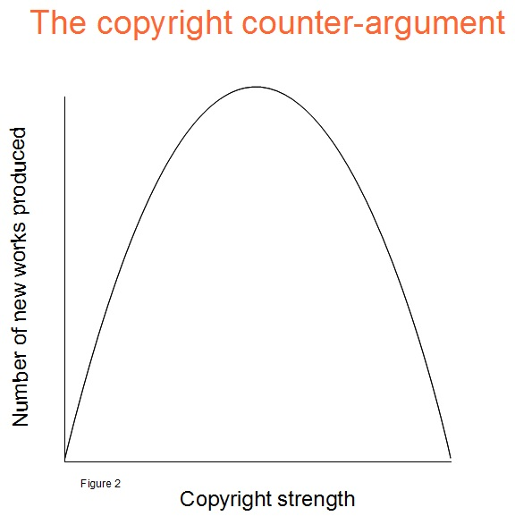
Creative expression: benefiting from your copyright & Using Copyright works of others
PART ONE: Copyright 101: Why? What? How?
Human rights and Incentives to create WORKS
A Bundle of (economic and moral) rights
Confidential information v Copyright Protection
Copyright Protection v Copyright Registration

Slide 4
Creative expression: benefiting from your copyright & Using Copyright works of others
PART TWO: Proof of Ownership
Notice to the World
(c) , NAME OF AUTHOR, DATE
Voluntary registration systems
Poor Man’s Copyright & Legal deposits
Importance of documentation

Slide 5
Creative expression: PART THREE: benefiting from your copyright
What type of WORK is this?
What are my RIGHTS?
Do I have PROOF of my rights?
How will I regulate USE of my WORK?
How will I COLLECT my income?

Slide 6
Creative expression: PART THREE: benefiting from your copyright
How will I regulate USE of my work?
How will I COLLECT my income?
Building your Catalogue: IP Portfolio
Leveraging your ©: Sale, Licencing & Securitisation
Protecting & Tracing your IP
Distribution requirements
Role of Agent and/or Publisher
Statutory/Compulsory licensing schemes & Collective Management Organisations

Slide 7
Creative expression: PART FOUR: Using Copyright works of others
What type of WORK is this?
Are RIGHTS infringed?
Who OWNS those rights?
Is my USE of the work EXEMPT from ©?
How do I get PERMISSION?

Slide 8
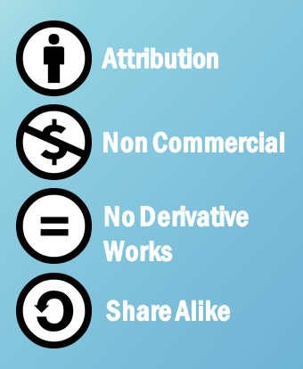
Creative expression: PART FOUR: Using Copyright works of others
Is my USE of the work EXEMPT from ©?
How do I get PERMISSION?
-Fair dealing and other Statutory Exemptions
-Orphan Works
-Rules of engagement/Terms of employment
- Creative Commons

Slide 9
Creative expression: PART FIVE: CASE STUDIES
Consider these:
You operate a business where the radio or a CD is played to add to ambiance or otherwise enhance your operations.
You hire a photographer to take pictures of your wedding; you later decide to use these photos in an ad campaign for your family run bakery to advertise wedding cakes.
You are a freelance writer that contributes to a national paper, you wish to publish a book of your articles. Does your position change if you are hired as a staff reporter?
You wish to make a cartoon film based on a recently published illustrated book whose rights must be secured.
You are the writer of a song that was recorded at Jamdisoun Records by an emerging artist named “Big Star” what are your options for earning an income from that song and who owes you money?

Slide 10
Creative expression: benefiting from your copyright & using the copyright works of others in your business
QUESTIONS

